Slide 1


SMART RIVER CLEANING MACHINE
PRESENTED BY
A.Nithin
2203A52071
CSE_AI&ML

Slide 2
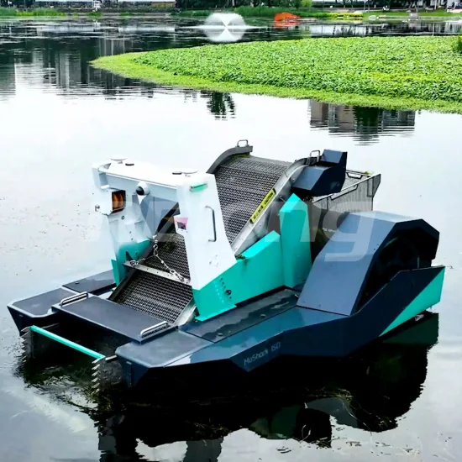
INTRODUCTION
Water pollution is a critical environmental challenge, particularly affecting rivers, which serve as vital sources of freshwater and habitats for diverse ecosystems. Smart River Cleaning Machines offer an innovative solution, combining advanced technologies to automate and Water pollution is a critical environmental challenge

Slide 3
CONTENT
Environmental Protection
Automation
Efficiency
Cost Savings
Data Collection

Slide 4
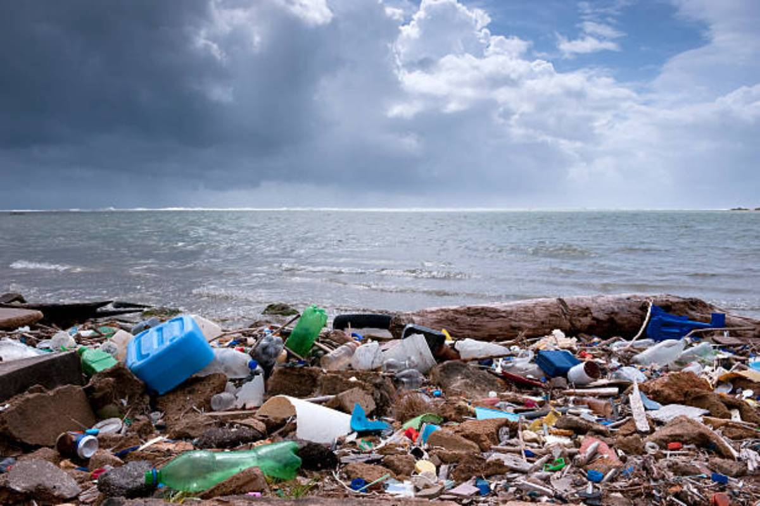
PROBLEM STATEMENT
Increasing water pollution in rivers and ponds due to floating waste and debris poses a significant threat to human health and aquatic life. Conventional manual cleaning methods are labor-intensive, costly, and time-consuming. There is a need for an efficient, eco-friendly, and automated solution to address this growing environmental issue.

Slide 5
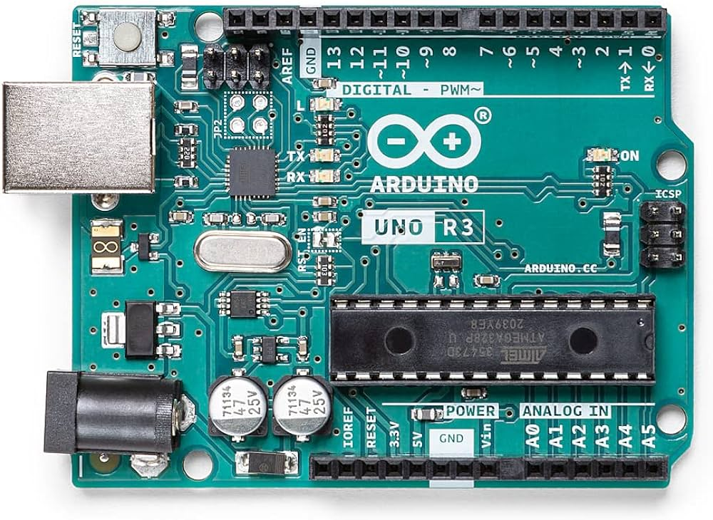
COMPONENTS
ARDUINO UNO
The Arduino Uno is an open-source microcontroller board based on the Microchip ATmega328P microcontroller and developed by Arduino.cc and initially released in 2010.[2][3] The board is with sets of digital and analog input/output (I/O) pins that may be interfaced to various expansion boards(shields) and other circuits.[1] The board has 14 digital I/O pins (six capable of PWM output), 6 analog I/O pins, and is programmable with the Arduino IDE (Integrated Development Environment), via a type B USB cable.[4] It can be powered by the USB cable or by an external 9-volt battery, though it accepts voltages between 7 and 20 volts. It is similar to the Arduino Nano and Leonardo.[5][6] The hardware reference design is distributed under a Creative Commons At…

Slide 6
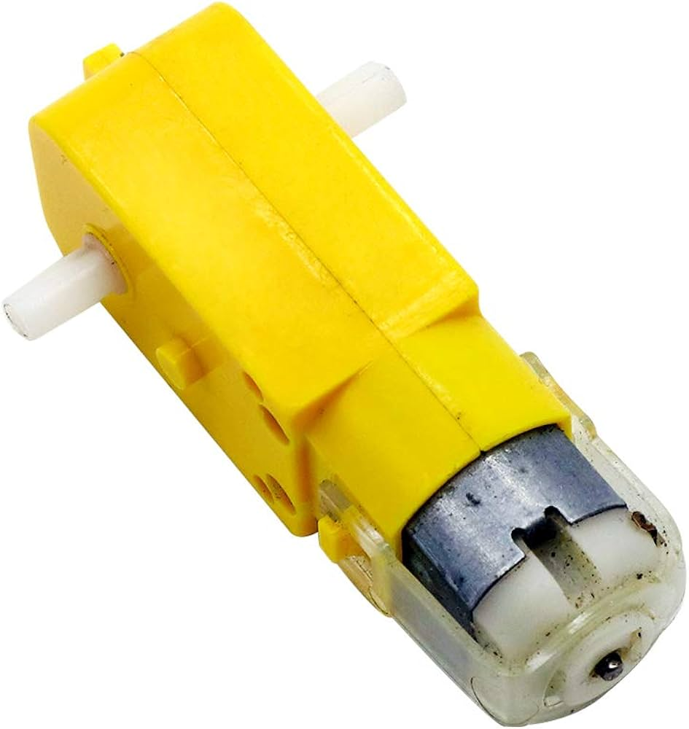
GEAR MOTOR
12V DC geared motors are for robotics and small industrial application, connect to wheel and outer world, very easy to use and available in different RPM, Mounting holes on the body & light weight makes it suitable for in-circuit/pcb placement

Slide 7
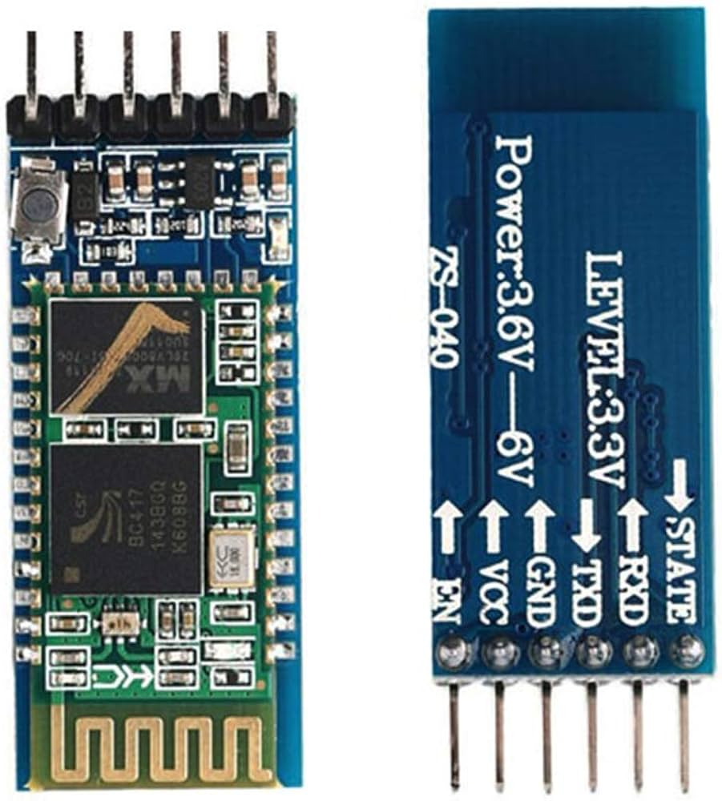
HC-05 BLUETOOTH MODULE
HC-05 is a Bluetooth module which is designed for wireless communication. This module can be used in a master or slave configuration.

Slide 8
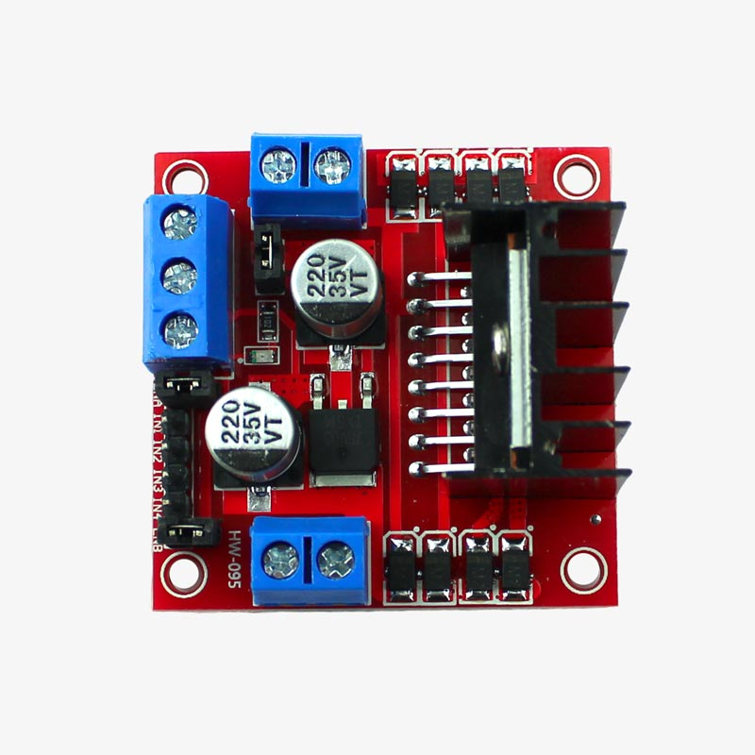
MOTOR DRIVER MODULE
L293D is a typical Motor driver or Motor Driver IC which allows DC motor to drive on either direction. L293D is a 16-pin IC which can control a set of two DC motors simultaneously in any direction. It means that you can control two DC motor with a single L293D IC. Dual H-bridge Motor Driver integrated circuit (IC).

Slide 9
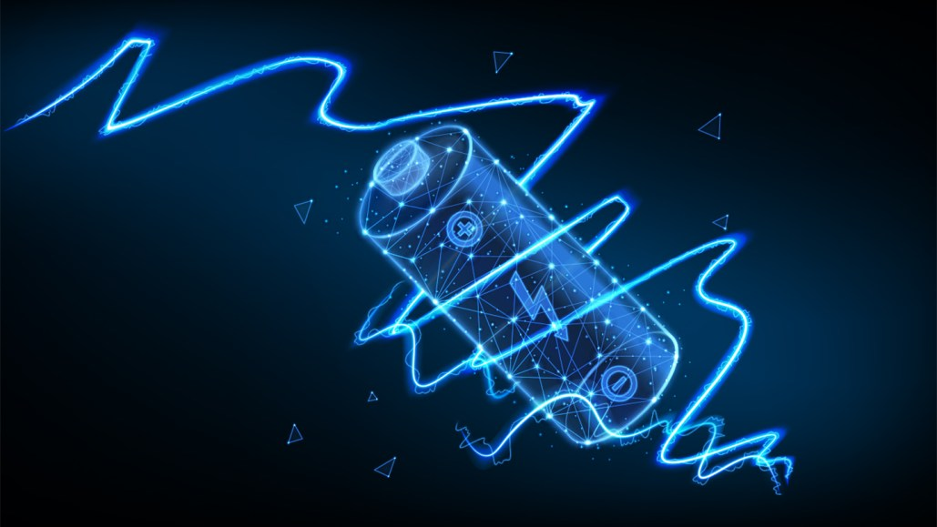
BATTERIES
This is a lead acid rechargeable battery. This machine consists of four batteries which gives output such as 2A, 8V for operation of setup.

Slide 10
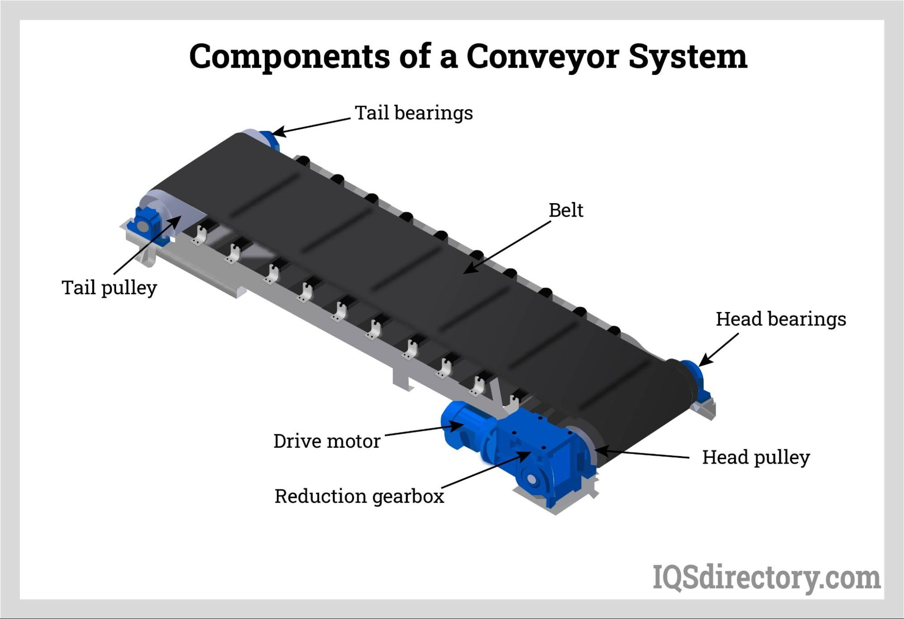
CONVEYER BELT
In this machine we used the polyvinyl Conveyor Belt. This is controlled by the Arduino uno system using a motor driver circuit. This collects all floating waste from the water surface and discharges it into the dustbin.

Slide 11
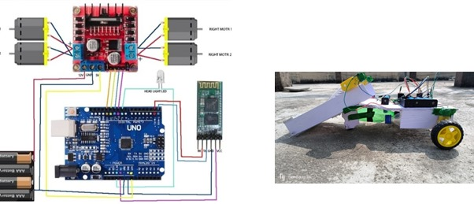
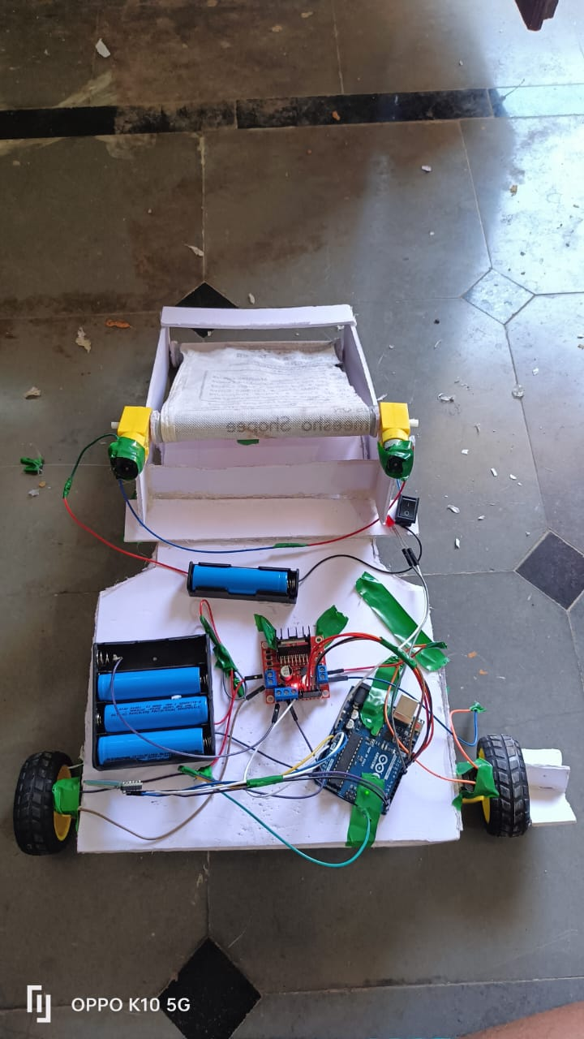
WORKING MODULE
The " Smart River Cleaning Machine" effectively removes floating waste from water bodies using a conveyor system controlled by an Arduino Uno. It is eco-friendly, cost-effective, and reduces the need for manpower by utilizing renewable energy sources. The machine is easy to operate and has potential for future enhancements to increase its waste collection capacity and scope.

Slide 12
CONCLUSION
This project is emphasis to provide flexibility in operation. This is easy in operation and cost of maintenance is low. Hence this project “ Smart River Cleaning Machine ” is mostly designed to make system very much economical and helpful to remove water impurities like plastics, trashes, water debris which is floating on river and pond surface. This is mainly very useful maintaining human health and for increasing the life of aquatic animals.

Slide 13


